Slide 1
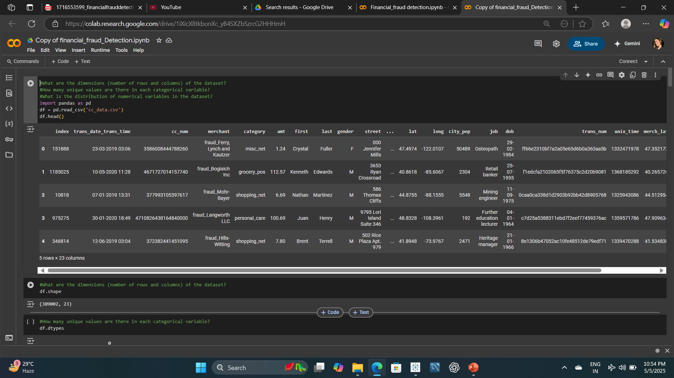

Slide 2
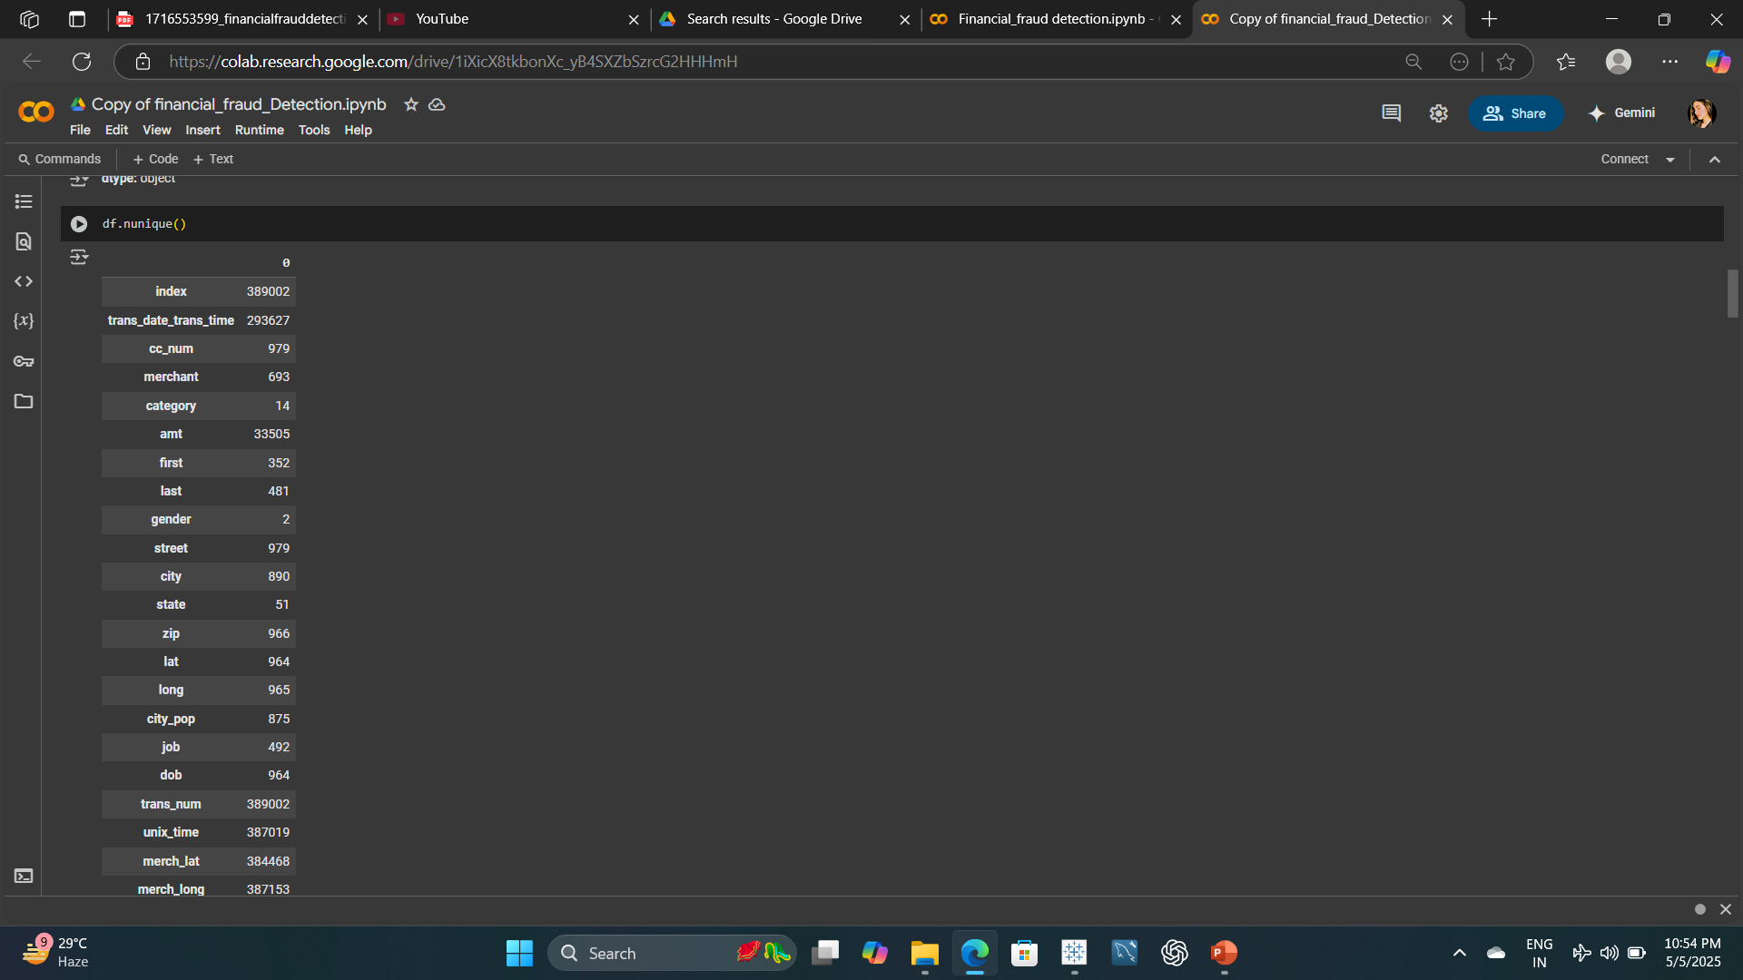

Slide 3
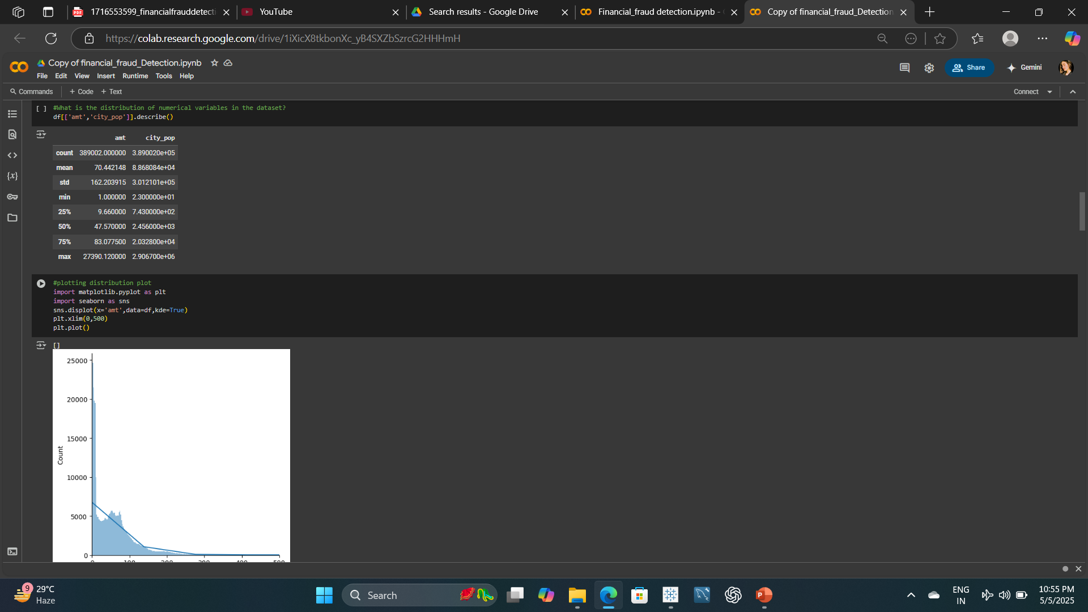

Slide 4
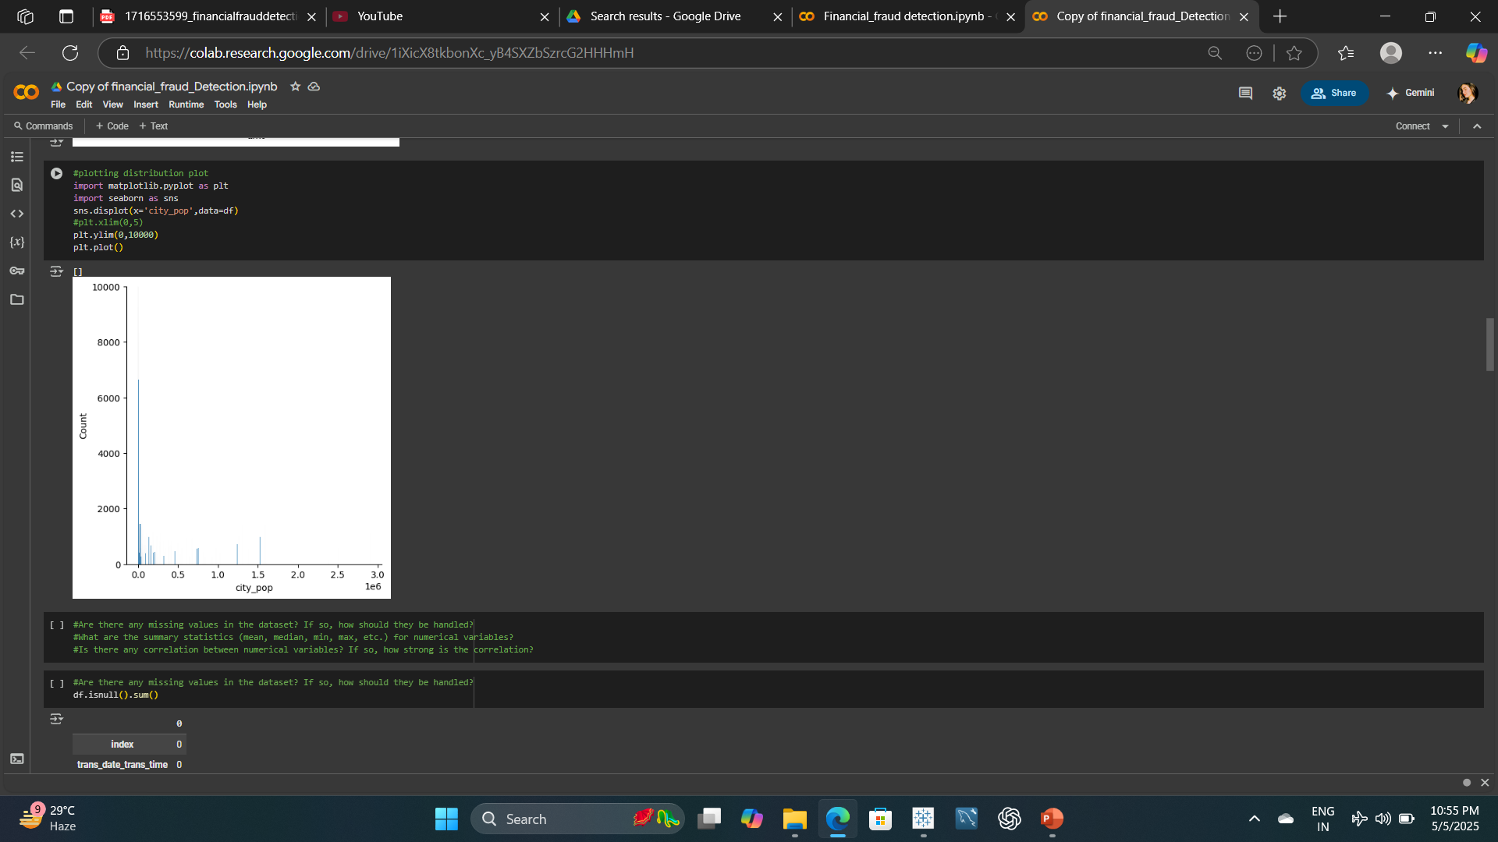

Slide 5
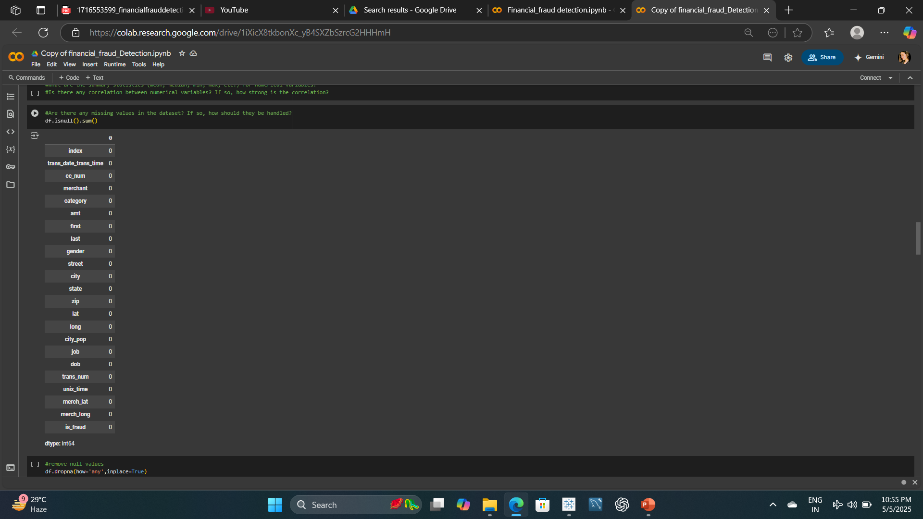

Slide 6
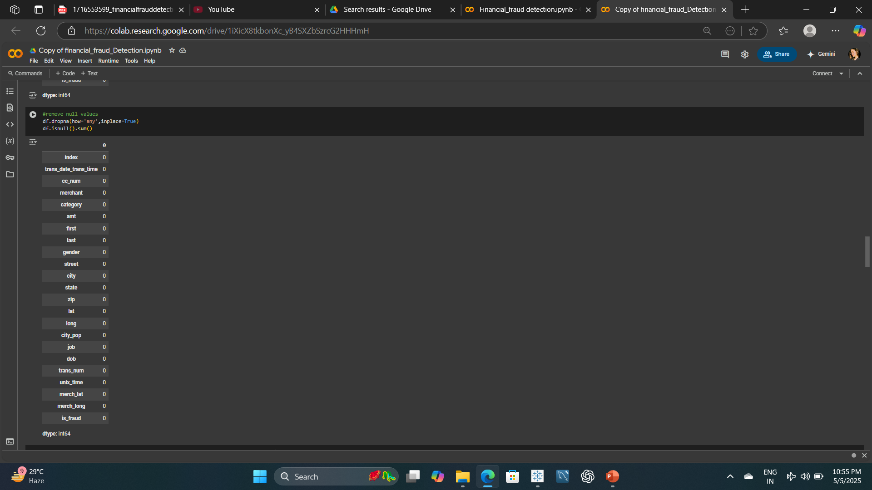

Slide 7
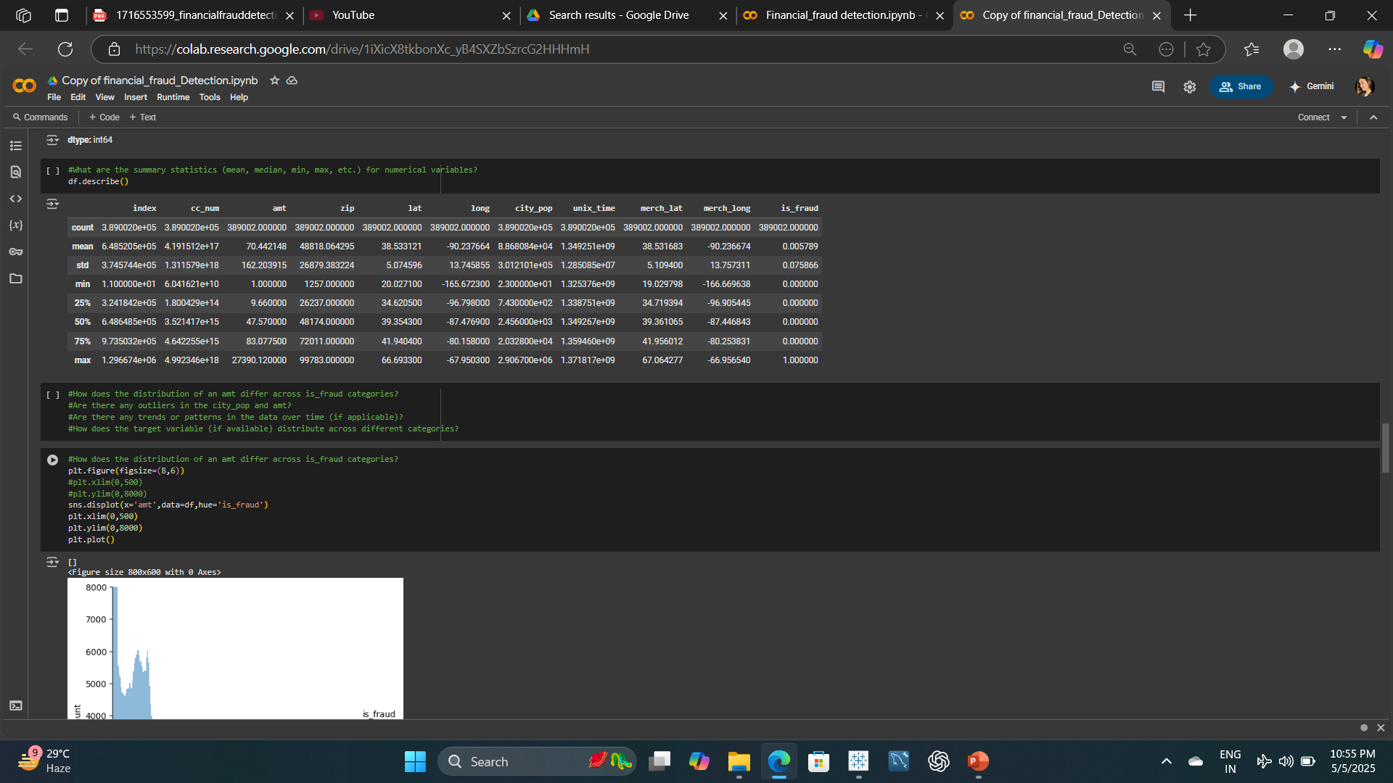

Slide 8
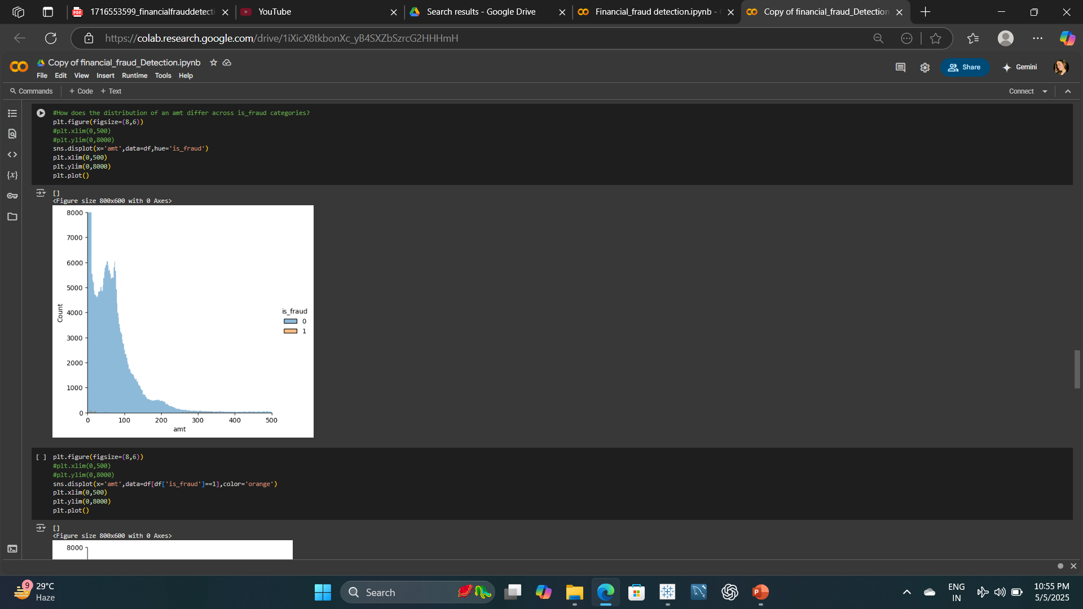

Slide 9
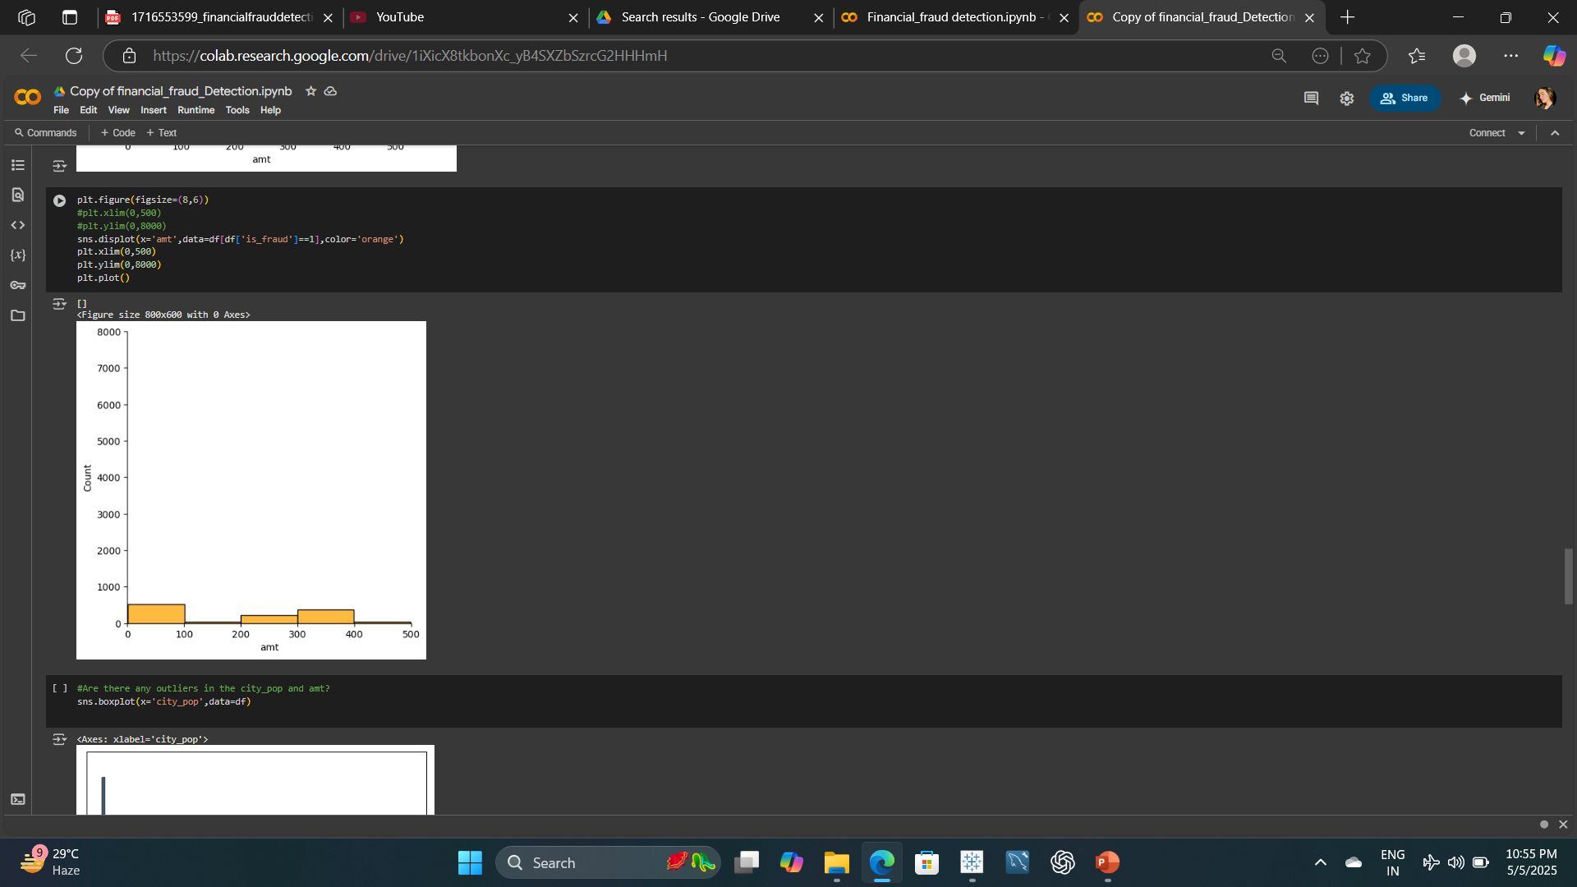

Slide 10
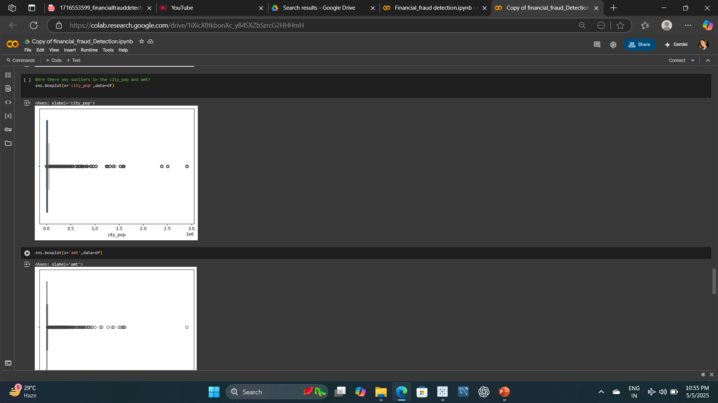

Slide 11
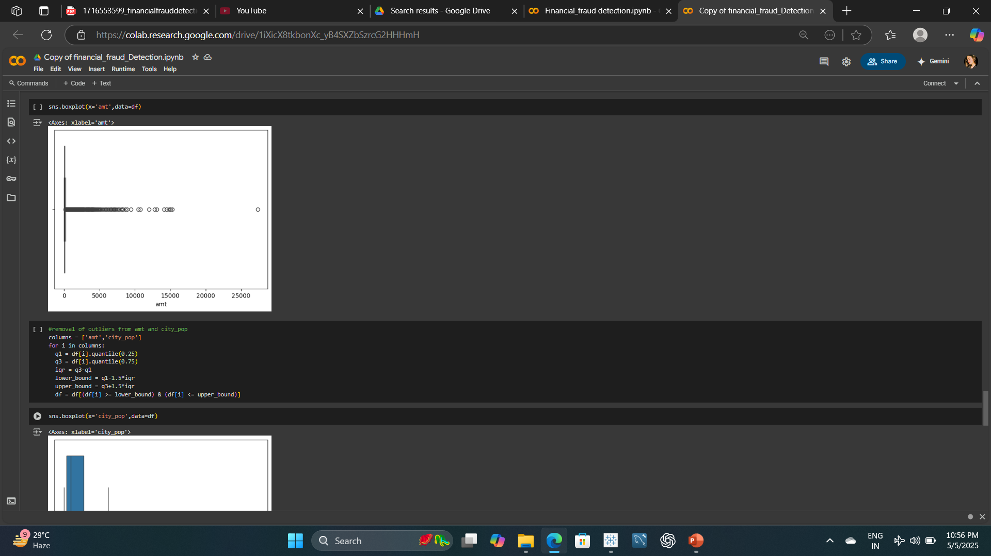

Slide 12
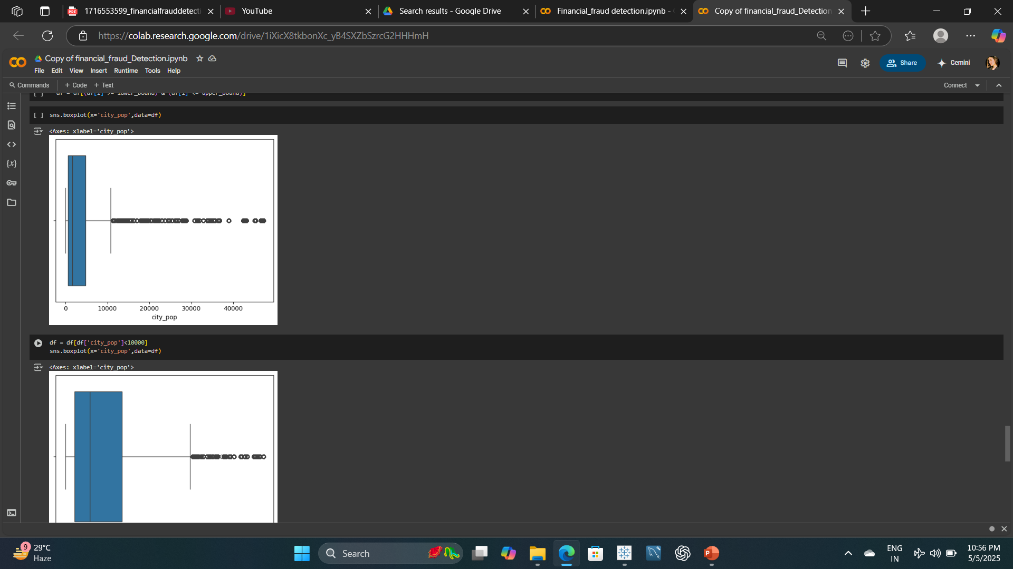

Slide 13
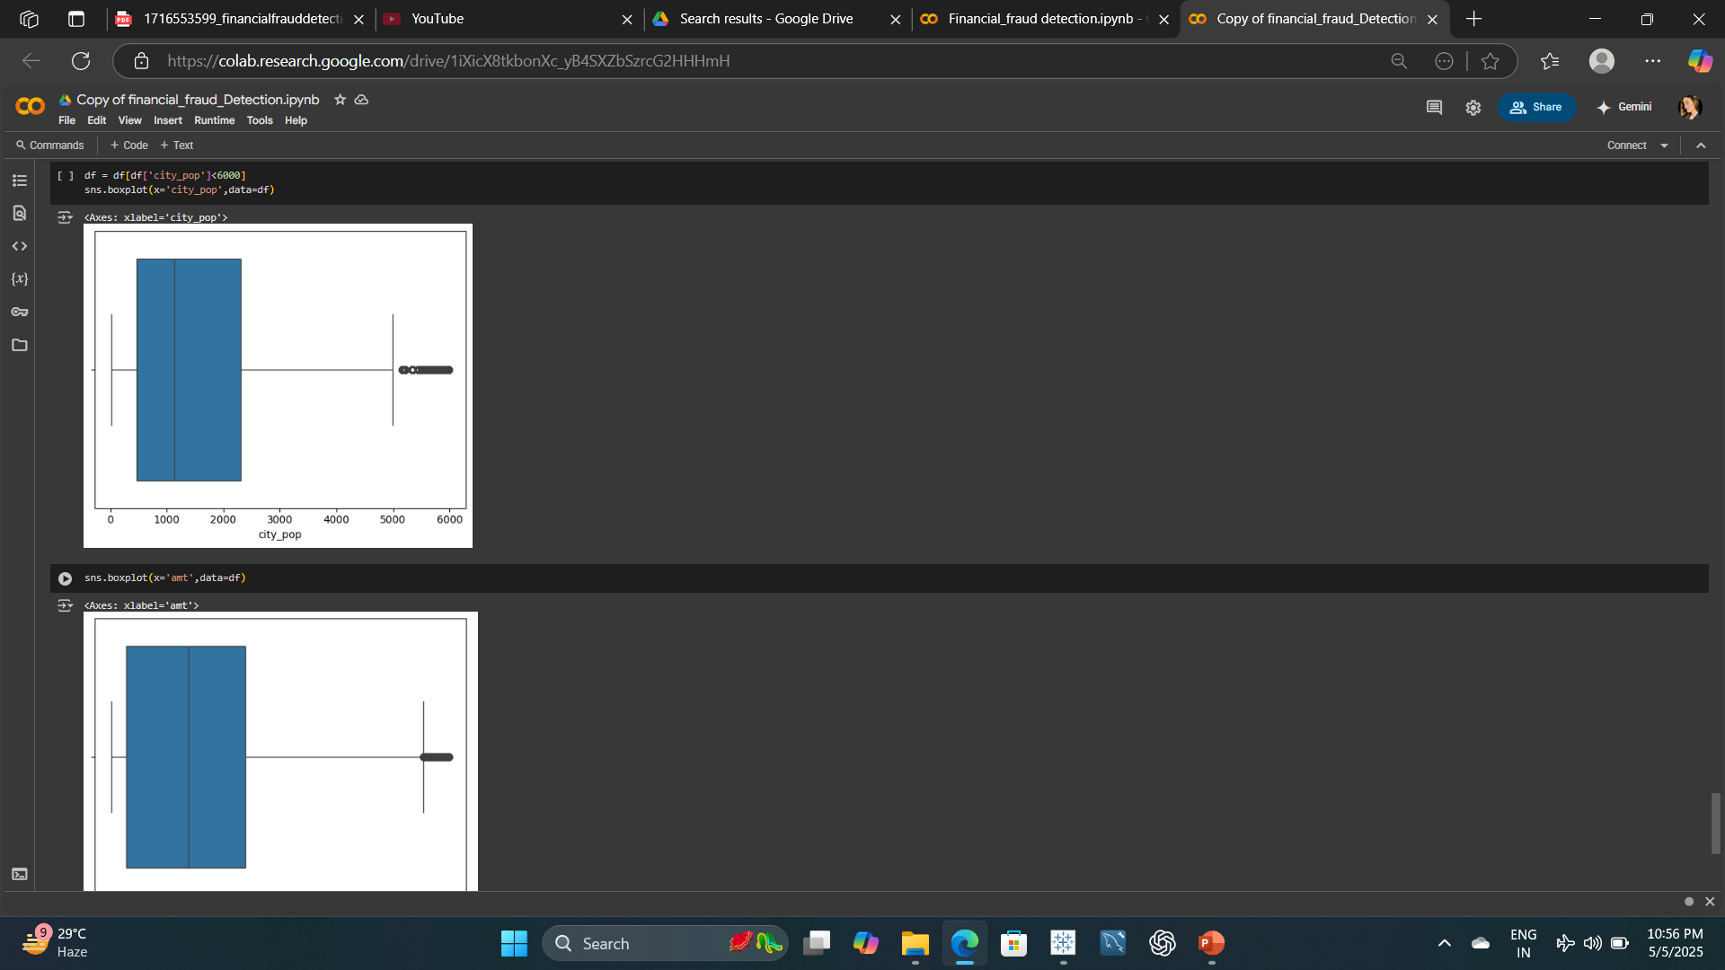

Slide 14
📊 Exploratory Data Analysis (EDA) Report
Project: Fraud Detection in Financial Transactions
---
🔍 Objective:
Analyze transaction data to detect fraudulent patterns and prepare data for building a fraud detection system.
---
📦 Dataset Overview:
- Source: Credit card transaction dataset
- Target Variable: `is_fraud` (0 = legitimate, 1 = fraud)
- Feature Types:
- Numerical: `amt`, `city_pop`, `lat`, `long`, etc.
- Categorical: `category`, `gender`, `merchant`, etc.
- Temporal: `trans_date_trans_time`
---
📐 1. Dataset Dimensions
- Use: `df.shape`
- Rows: [Number of transactions]
- Columns: [Number of features]

Slide 15
🔤 2. Categorical Features (Unique Values)
```python
for col in df.select_dtypes(include='object'):
print(col, df[col].nunique())
import pandas as pd
import seaborn as sns
import matplotlib.pyplot as plt
# Step 3: Distribution of Numerical Variables
df.hist(figsize=(12, 10), bins=30)
plt.tight_layout()
plt.show()
# Step 4: Missing Values
missing_values = df.isnull().sum()
print("Missing Values:\n", missing_values)
# Step 5: Summary Statistics
summary_stats = df.describe()
print("Summary Statistics:\n", summary_stats)

Slide 16
# Step 6: Correlation Analysis
plt.figure(figsize=(10, 8))
sns.heatmap(df.corr(numeric_only=True), annot=True, cmap='coolwarm', fmt='.2f')
plt.title("Correlation Heatmap")
plt.show()
# Step 7: Class Imbalance
fraud_counts = df['is_fraud'].value_counts(normalize=True)
print("Fraud Class Distribution:\n", fraud_counts)
# Step 8: amt Distribution by is_fraud
plt.figure(figsize=(8, 5))
sns.boxplot(x='is_fraud', y='amt', data=df)
plt.title("Transaction Amount by Fraud Status")
plt.show()
# Step 9: Time-Based Trends
df['trans_date_trans_time'] = pd.to_datetime(df['trans_date_trans_time'])
df.set_index('trans_date_trans_time')['is_fraud'].resample('D').sum().plot(figsize=(12, 5))
plt.title("Fraudulent Transactions Over Time")
plt.ylabel("Fraud Count")
plt.xlabel("Date")
plt.show()

Slide 17
# Step 10: Fraud Rate by Category
fraud_by_category = df.groupby('category')['is_fraud'].mean().sort_values(ascending=False)
print("Fraud Rate by Category:\n", fraud_by_category)
# Step 11: Outlier Detection
plt.figure(figsize=(14, 5))
plt.subplot(1, 2, 1)
sns.boxplot(x=df['amt'])
plt.title("Boxplot of Transaction Amount")
plt.subplot(1, 2, 2)
sns.boxplot(x=df['city_pop'])
plt.title("Boxplot of City Population")
plt.tight_layout()
plt.show()
🧹 12. Data Quality Checks
Remove duplicates
Validate timestamps
Check for invalid amounts or coordinates

Slide 18
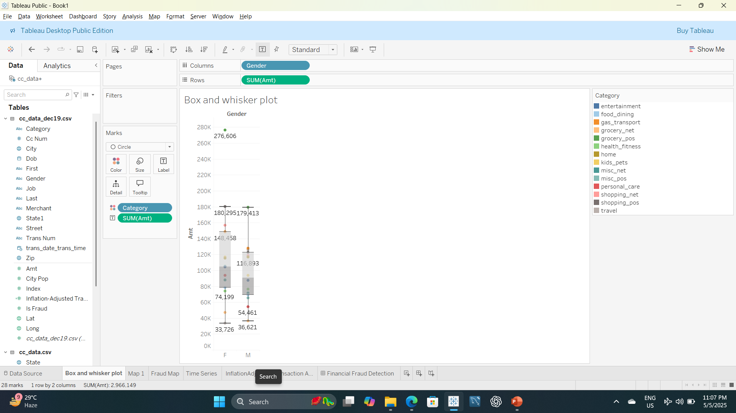

Slide 19
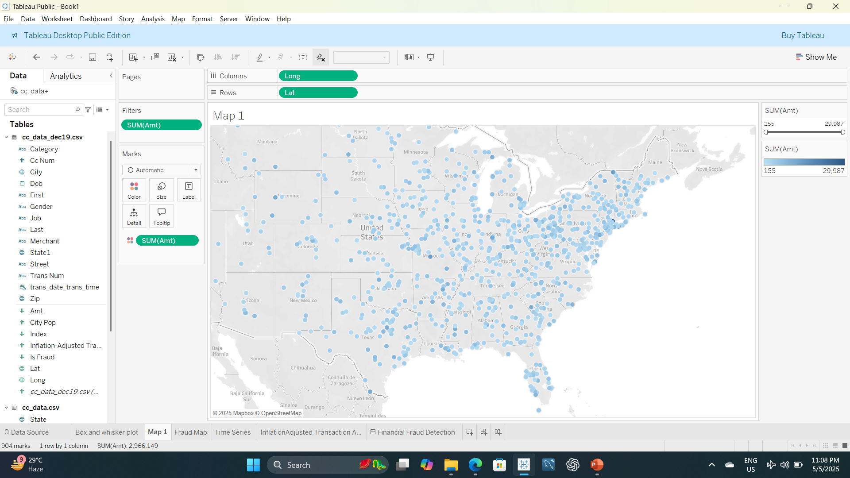

Slide 20
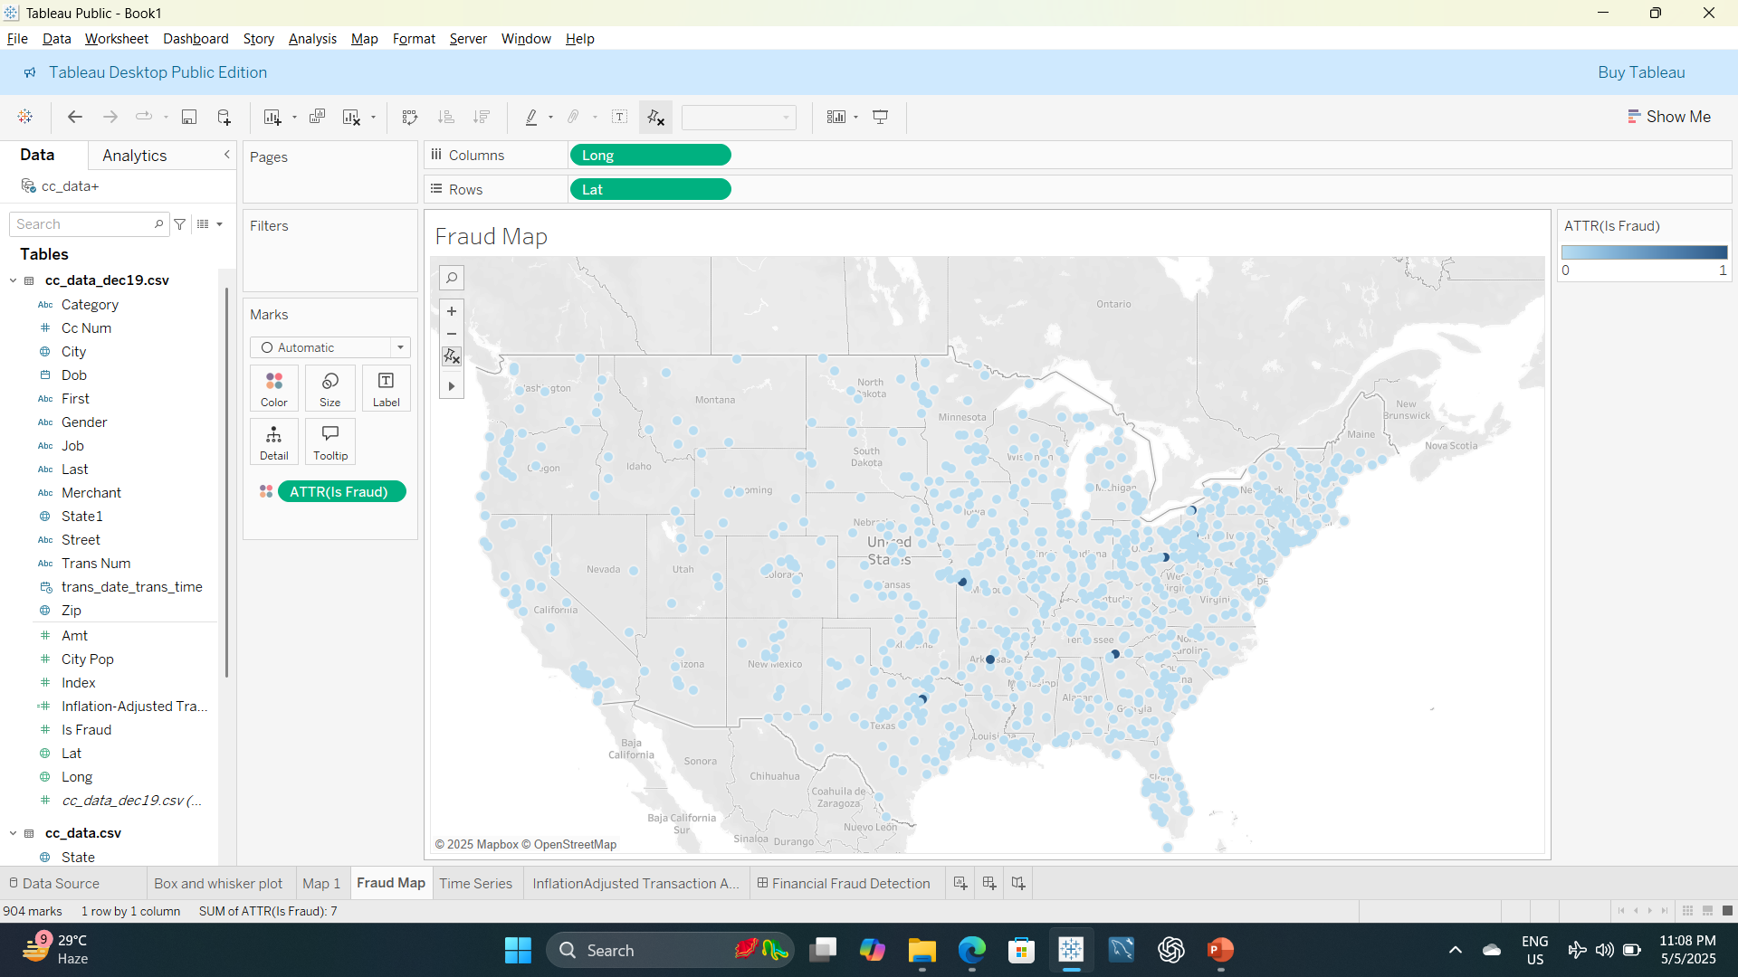

Slide 21
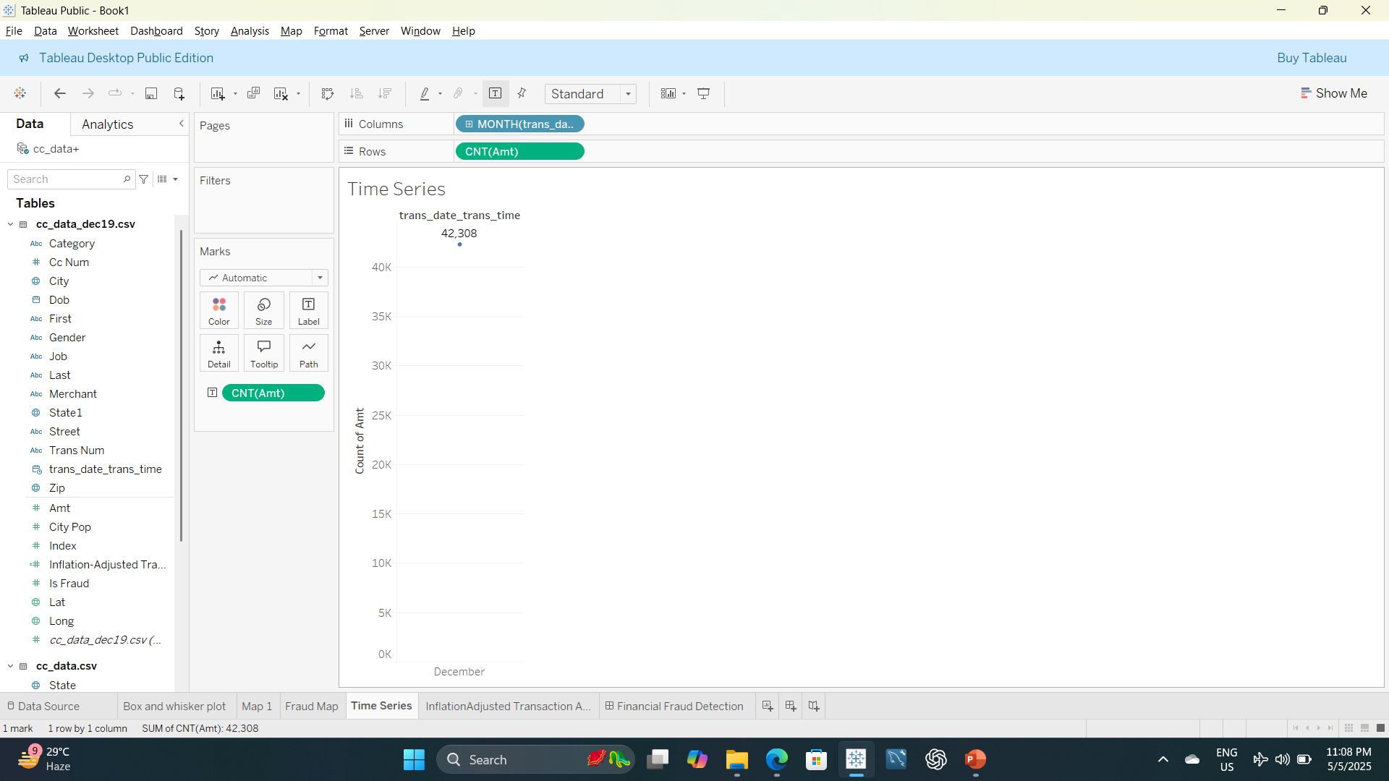

Slide 22
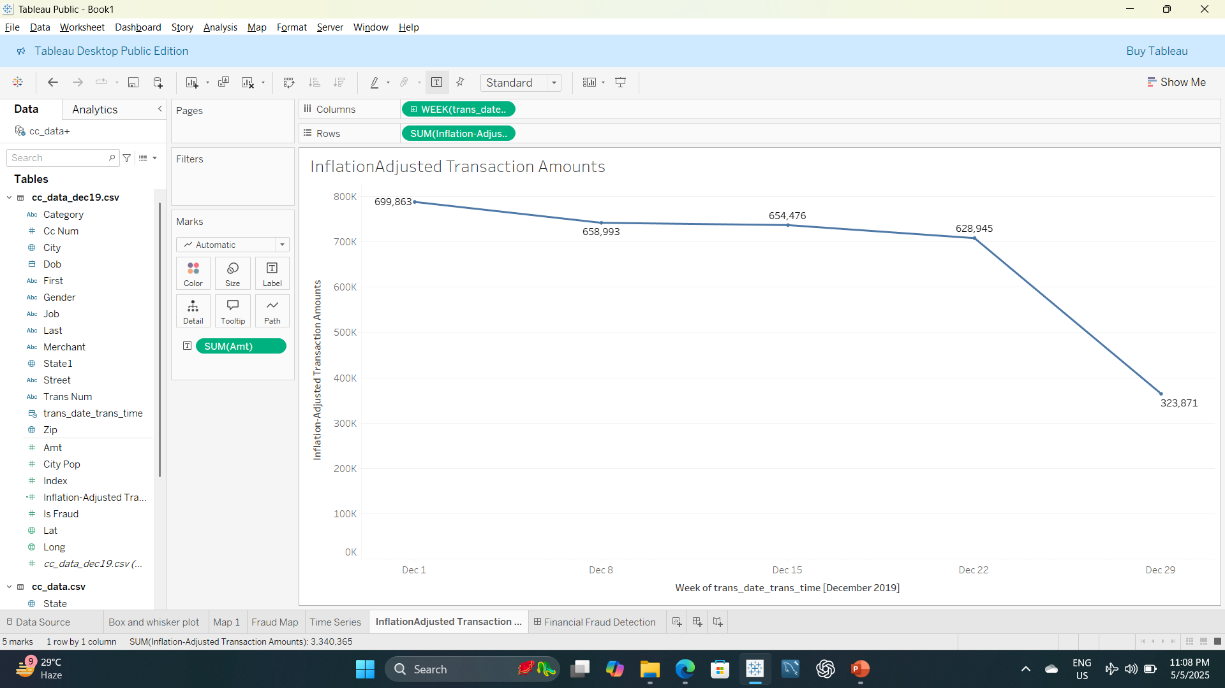

Slide 23
